Slide 1

A Project Presentation on
CLUSTERING HEART DISEASE
&
TRAFFIC MORTALITY RATE

Slide 2




TEAM-MATES
01
02
03
04
MOHAMMED SAFWAN ASLAM KAZI
1270795
MEHREET SINGH BAJAJ
MAITRY JARIWALA
RISHABH BADJATYA
1274698
1275288
1270662
mbajaj@nyit.edu
mkazi01@nyit.edu
mjariw01@nyit.edu
rbadjaty@nyit.edu

Slide 3


CLUSTERING HEART DISEASE PATIENT
Insert the Sub Title of Your Presentation

Slide 4
AGENDA
01
MOTIVATION OF THE PROJECT
02
HOW TO OVERCOME ?
03
OPERATING ENVIRONMENT
04
DATA & DATASET
05
R LIBRARIES
06
LOADING & CLEANING
07
ANALYSIS
08
WORK DONE

Slide 5

MOTIVATION
Heart disease
common health conditions - individual faces at some stage of their life
Unpredictable
Doctors- not able to predict the disease on time correctly
Deaths
610,000 people die - heart disease
In 2009 - more than half of the men suffered with death - heart disease
Annually- 370,000 die - Coronary heart disease (CHD) - Most common

Slide 6

HOW TO OVERCOME ?
DATA – MINING
ML CLUSTERING
MODEL
CONCLUDING
Loading libraries & data
Cleaning
Transforming
Visualization
Correlation
Using Unsupervised learning clustering techniques
By grouping patients with similar characteristics can respond to same treatment in an efficient way
Doctors will be able to make decision and treat the patent on time with the same treatment
Comparing and Choosing from different clustering techniques

Slide 7



OPERATING ENVIRONMENT

Slide 8

source
V.A medical Center in Long Beach
Choosing Data wisely
DATA
ATTRIBUTES
76
MOST RELEVANT
14
TARGET VARIABLE
1
0

Slide 9




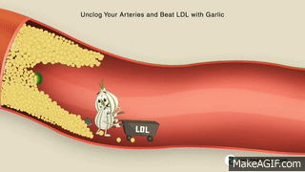


DATA DICTIONARY
Age
Resting Blood Pressure (trestbps)
Age of the subject
Resting blood pressure in mm Hg
Sex
Serum cholesterol (chol)
Gender of the subject
0= female
1=male
serum cholesterol in mg/dl
Chest Pain (CP)
Fasting Blood Sugar (fbs)
Type of chest-pain experienced
1 = typical angina 2 = atypical ang
3 = non-angina pain
4 = asymptomatic angina
Fasting blood sugar level relative to
120 mg/dl
0 = fasting blood sugar <= 120 mg/dl
1 = fasting blood sugar > 120 mg/dl

Slide 10
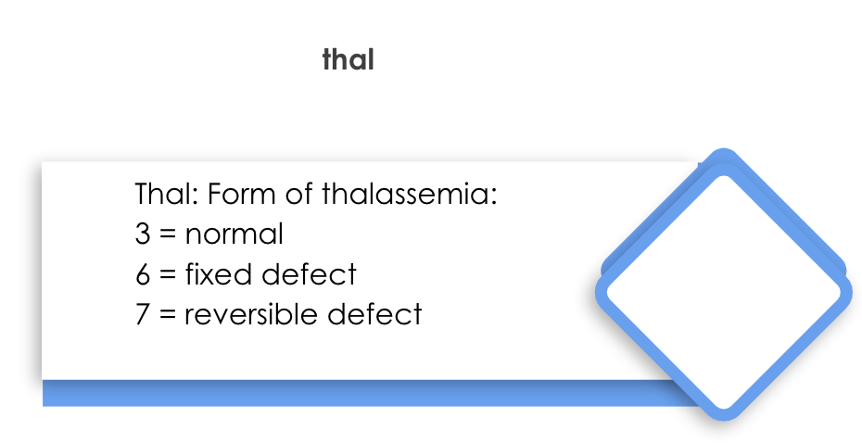






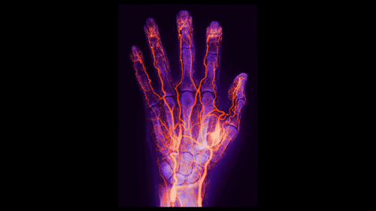
Resting ECG( restecg)
ST Depression Induced by Exercise Relative to Rest (Oldpeak)
Resting electrocardiographic result
0 = normal
1 = ST-T wave abnormality
2 = left ventricle hypertrophy
ST Depression of subject
Peak Exercise ST Segment (Slope)
Max Heart Rate Achieved (thalach)
The slope of the peak exercise ST segment
-- Value 1: upsloping
-- Value 2: flat
-- Value 3: downsloping
Max heart rate of subject
Exercise Induced angina (exang)
ca
exang: exercise induced angina
1 = yes
0 = no
Number of Major Vessels (0-3) Visible on Fluoroscopy

Slide 11


Diagnosis of Heart Disease
(target)
Heart Disease
Indicates whether subject is suffering from heart
disease or not:
0 = absence
1, 2, 3, 4 = heart disease present

Slide 12

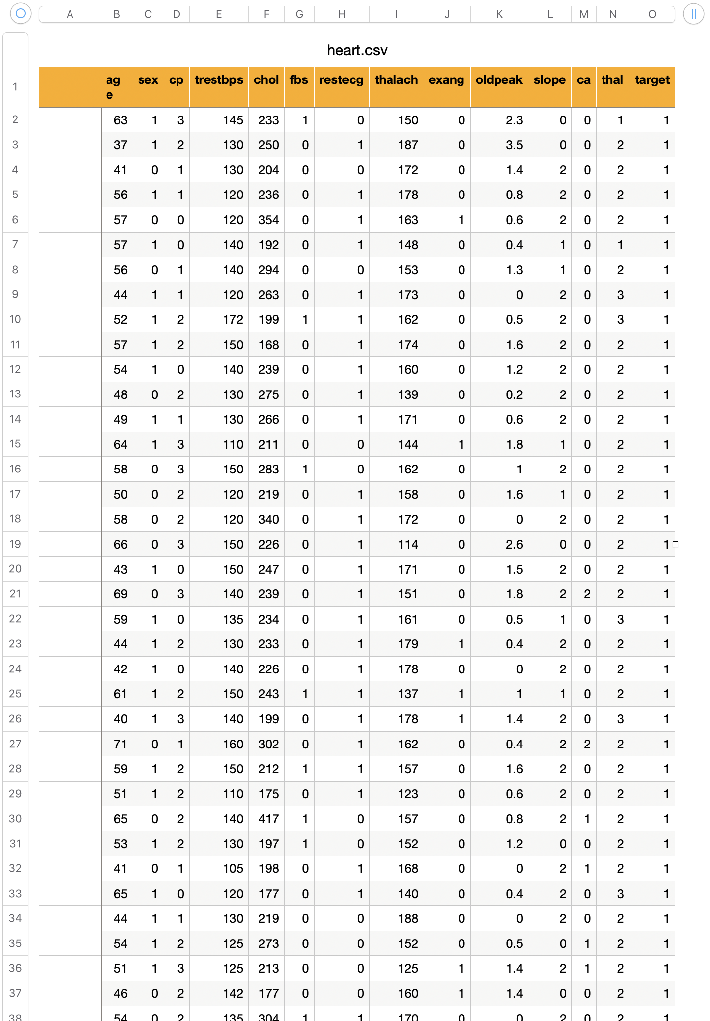
DATASET
Let's look into our dataset

Slide 13

LIBRARIES USED
R
ggvis
Tidyverse
corrplot
dplyr
ggplot2

Slide 14
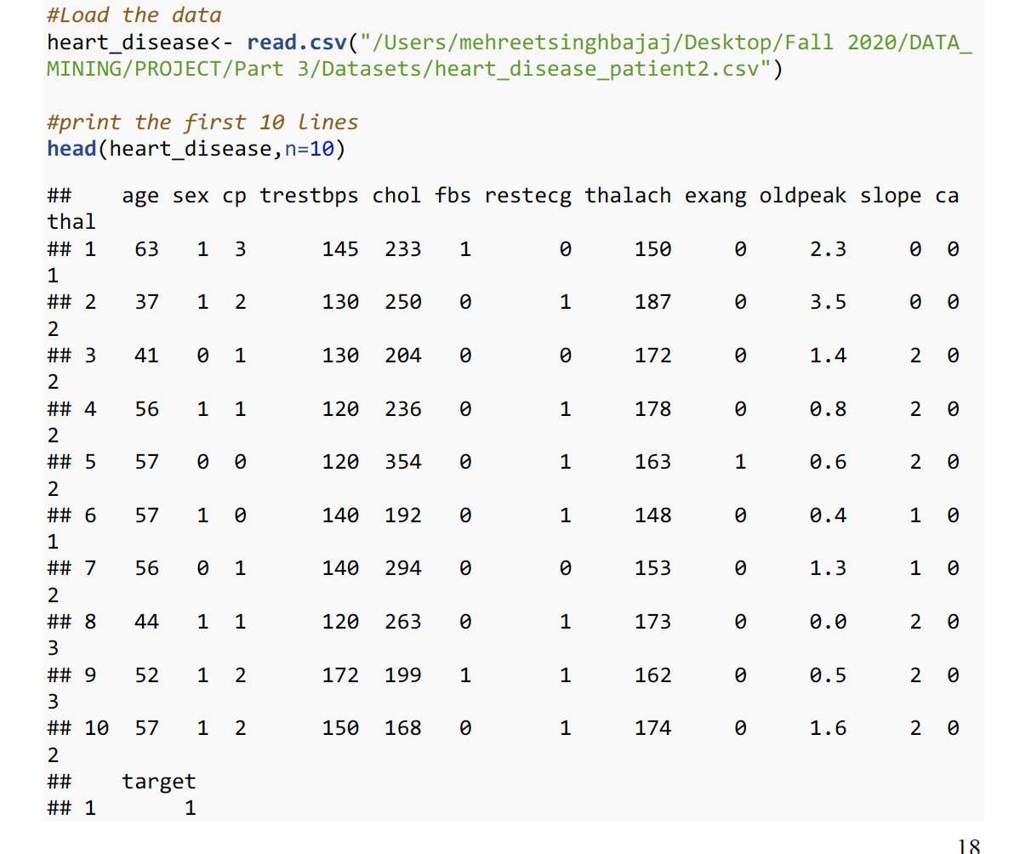
LOADING THE DATA

Slide 15

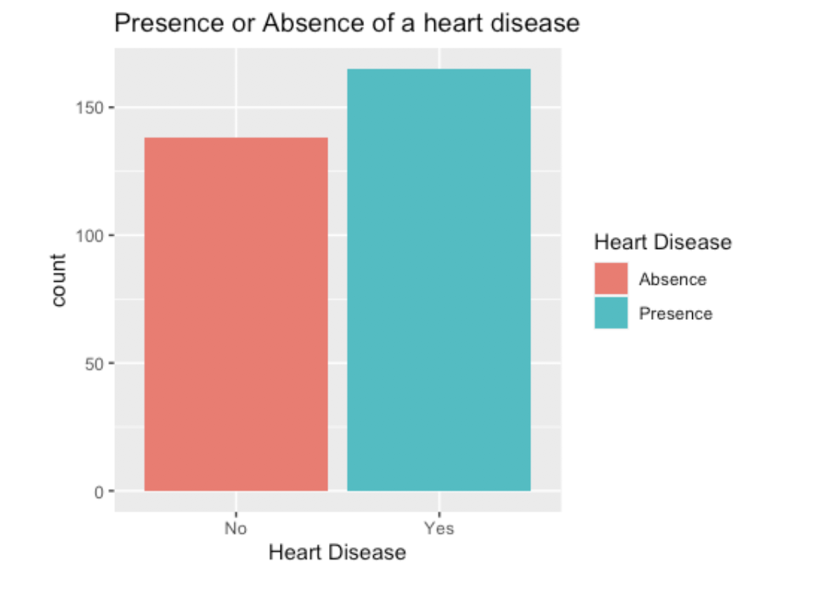
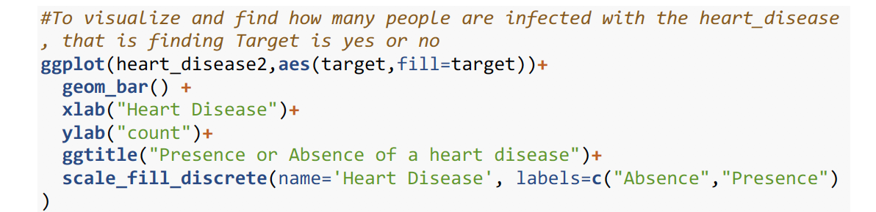
ANALYSIS AND VISUALIZATION

Slide 16

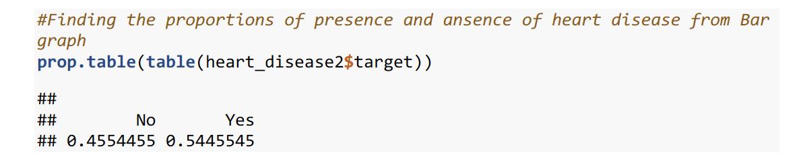
Is our data balanced ?

Slide 17
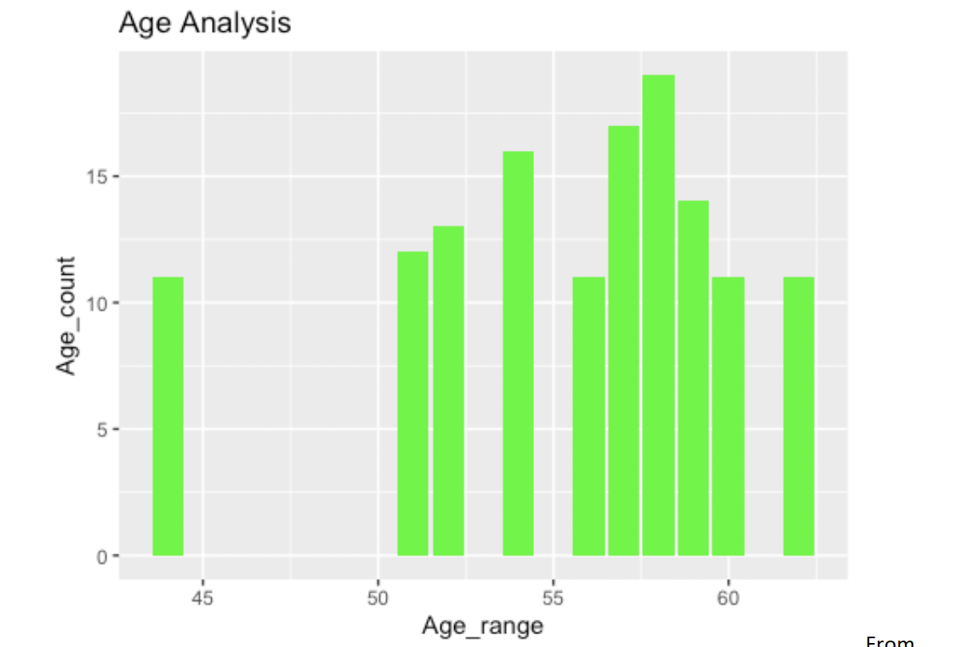

Countplot (histogram for categorical values)

Slide 18
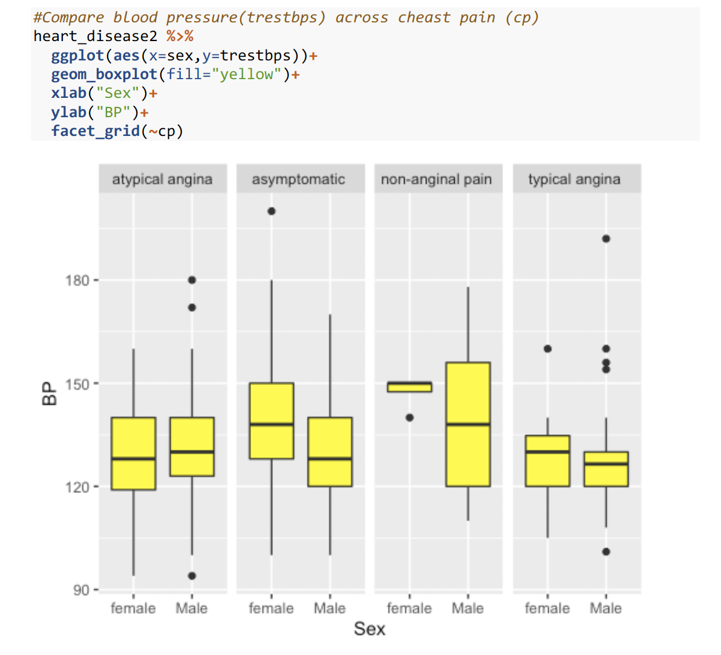

Notice the outliers here ?

Slide 19
Notice the outliers here ?

Slide 20
Notice the outliers here ?

Slide 21
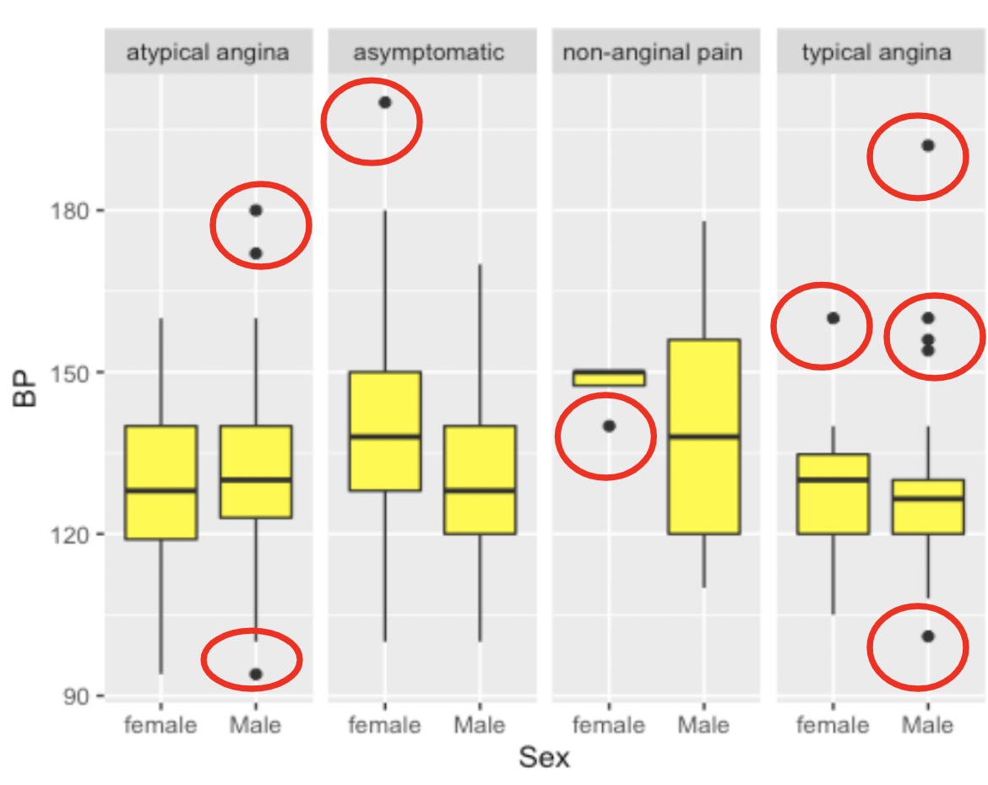

atypical angina
female = 0 outlier ; male= 3 outliers
Asymptomatic -
female = 1 outlier ; male= 0
non - anignal pain-
female = 1 ; male= 0
typical anigna - female = 1 ; male= 5
What can we conclude from these ?

Slide 22
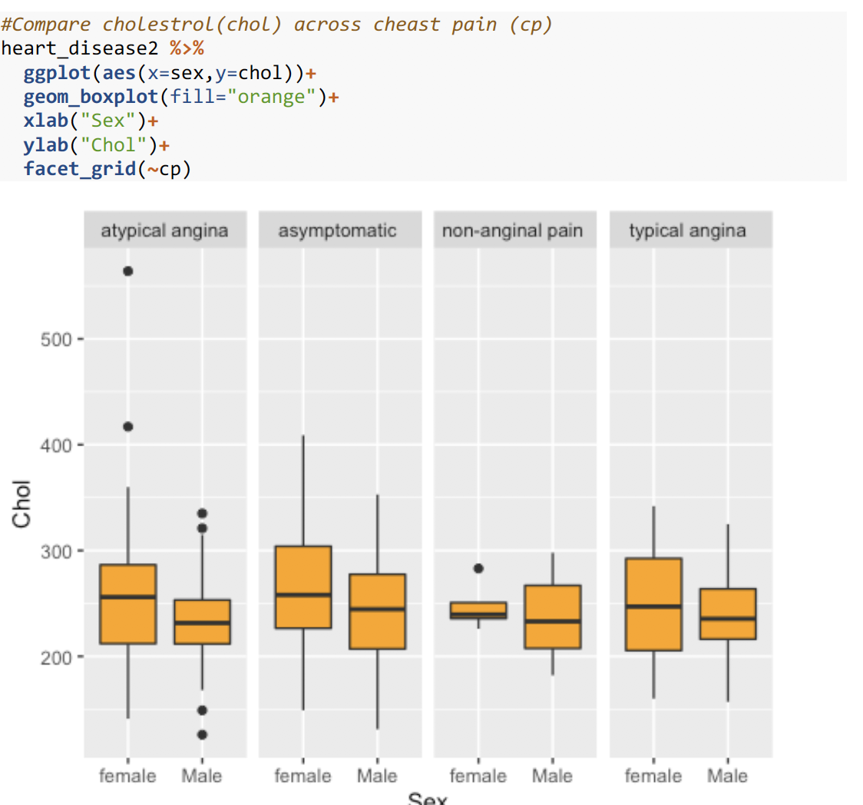

Slide 23
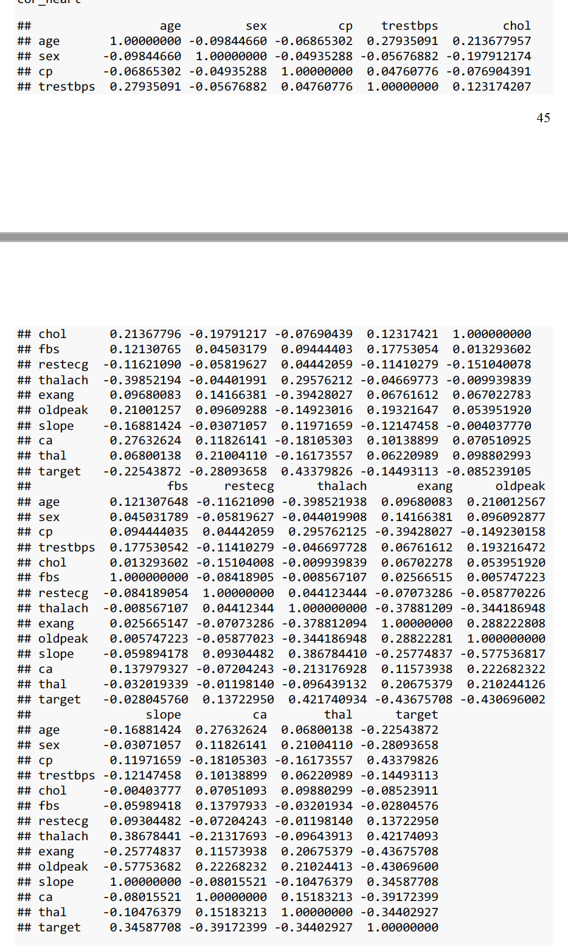
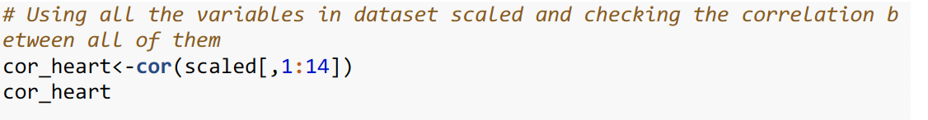

CORRELATION ANALYSIS
Magic !!

Slide 24

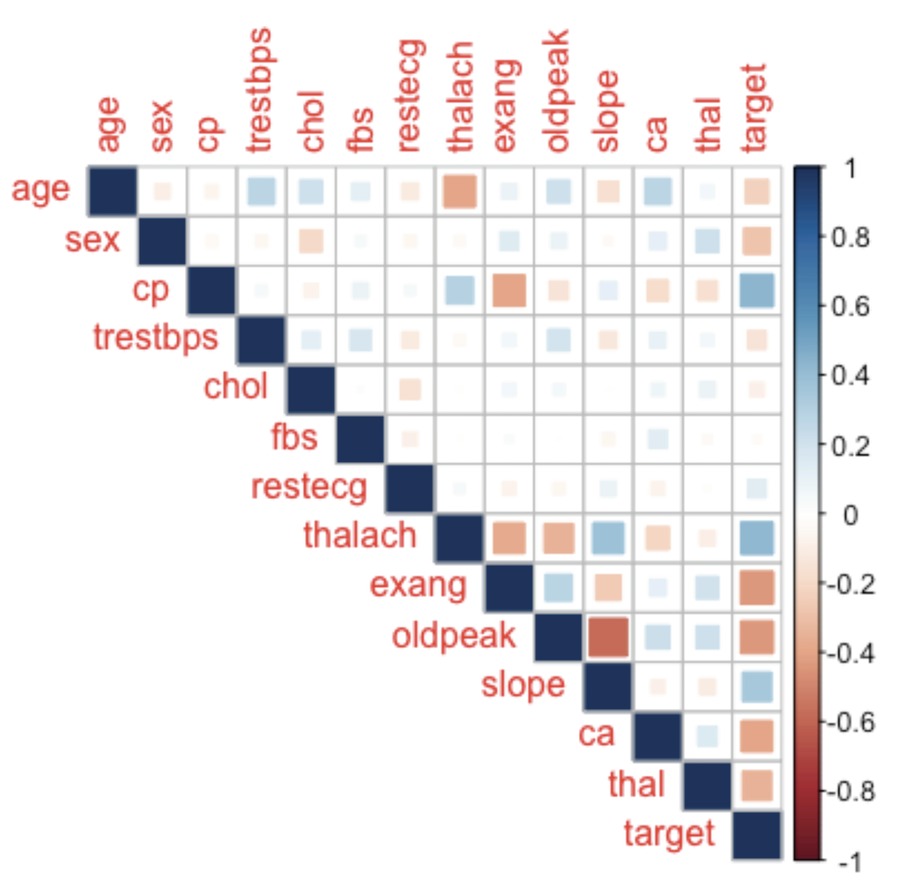
Graphs are always better !!

Slide 25
OUR MAIN ALGORITHMS
USING K-MEANS
HIERARCHICAL CLUSTERING COMPLETE
HIERARCHICAL CLUSTERING SINGLE
GROUPING !
Let’s start Grouping

Slide 26
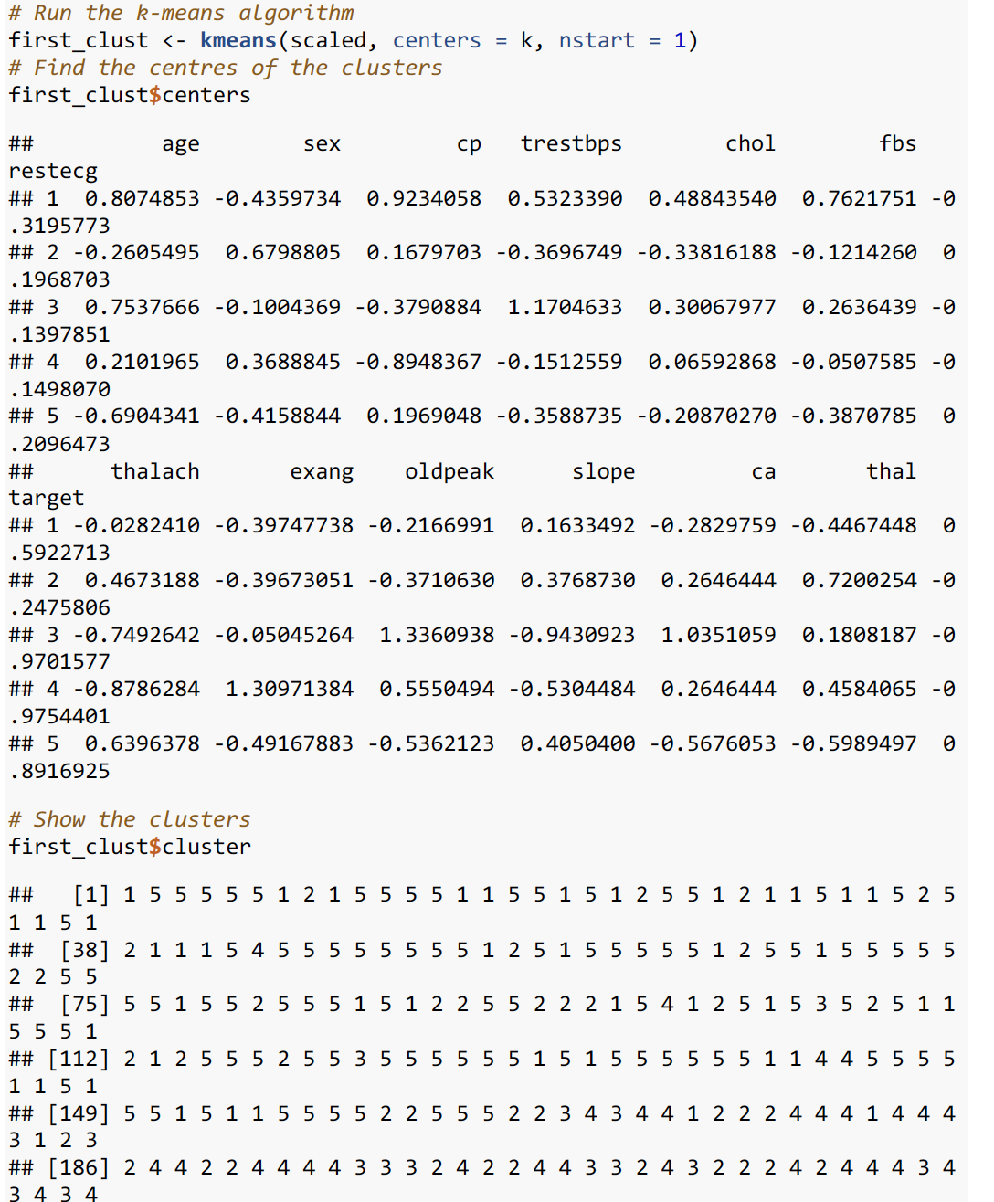
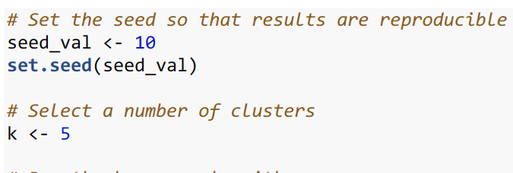
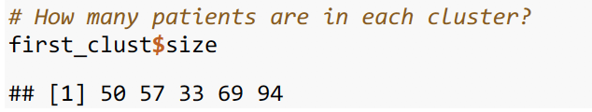
K - MEANS (1st round )

Slide 27
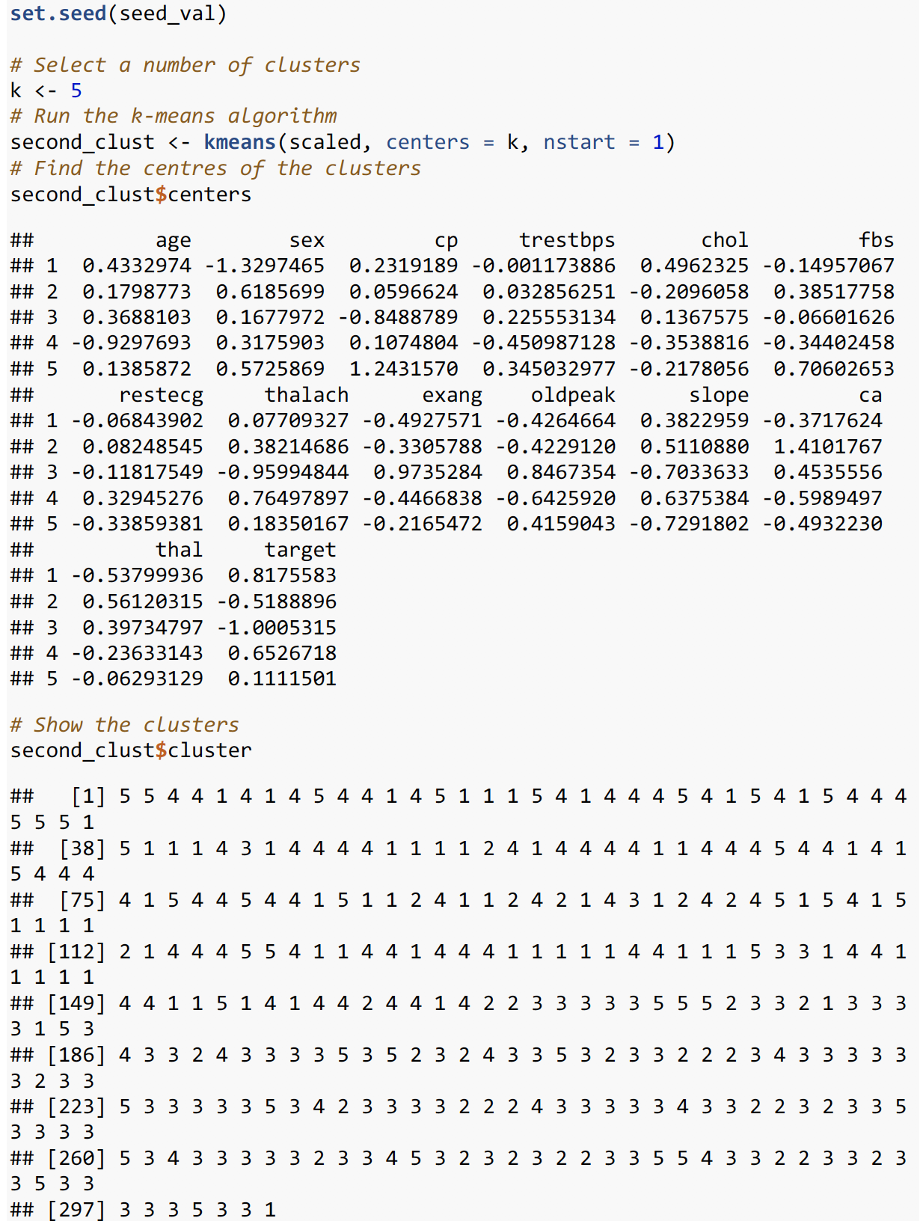
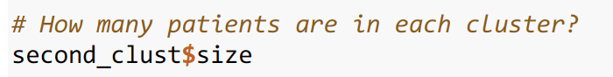
K - MEANS (2nd round )
If the algorithm is genuinely grouping similar observations (as opposed to clustering noise), then cluster assignments will be somewhat robust between various iterations of the algorithm.
The same patients would be grouped even when the algorithm is initialized at different random points

Slide 28
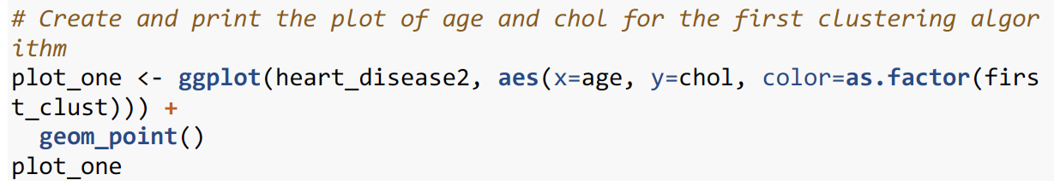
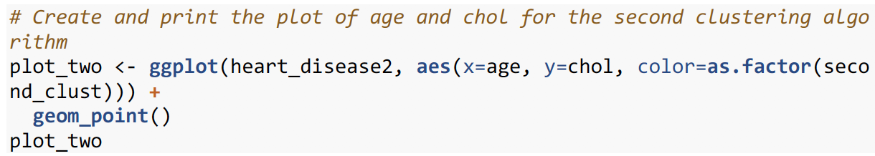
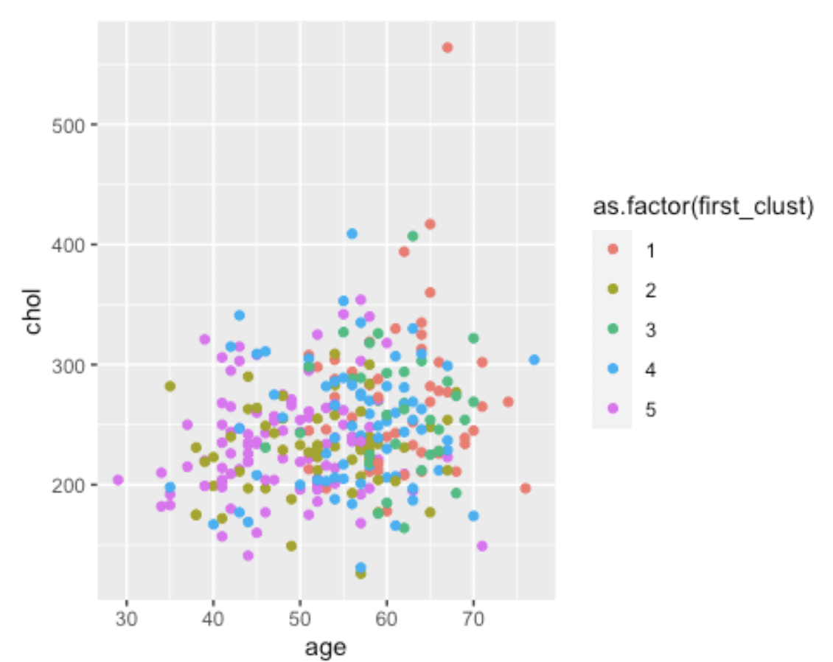
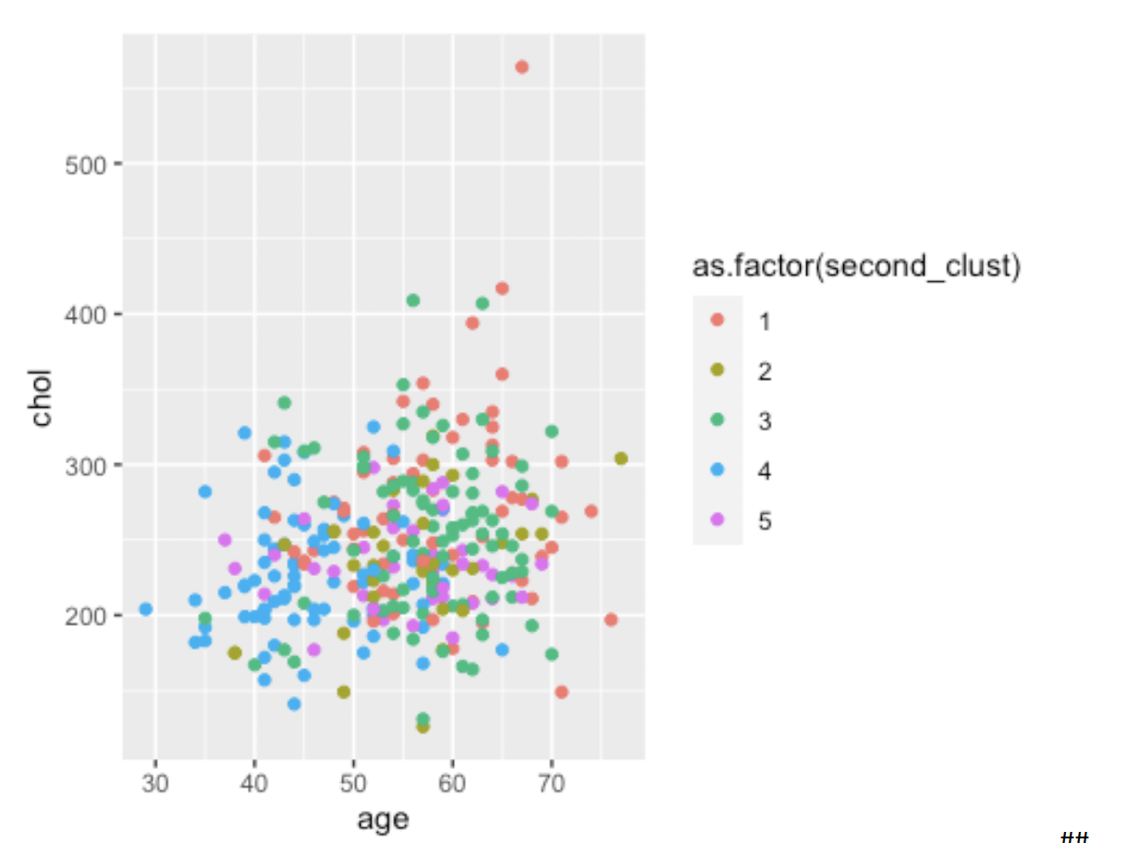


Slide 29
ANALYSIS OF K-MEANS
NOT SUCCESSFUL!!
=
K- Means round 1 clustering
K- means round 2 clustering
50 57 33 69 94
63 35 88 77 40

Slide 30
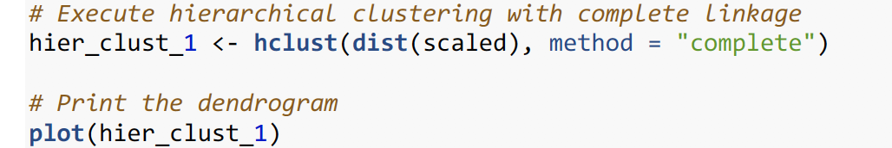
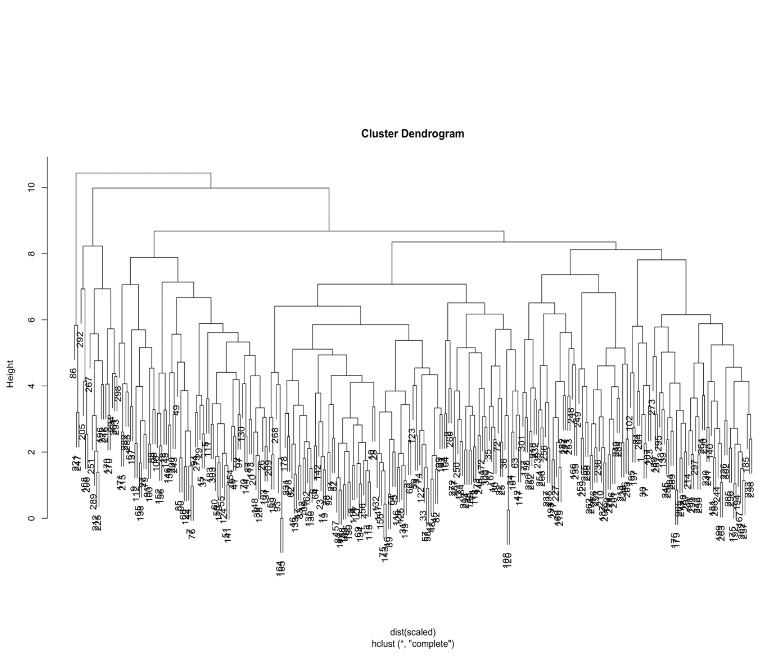
Hierarchical clustering also does not require the number of clusters to be selected before running the algorithm
Uses Dendrogram
Efficient with heart disease patient dataset
HIERARCHICAL

Slide 31
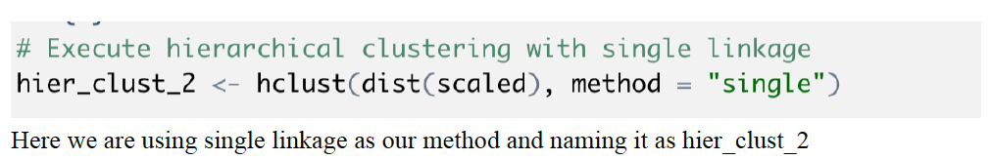
Hierarchical clustering also does not require the number of clusters to be selected before running the algorithm
Uses Dendrogram
Efficient with heart disease patient dataset
HIERARCHICAL

Slide 32
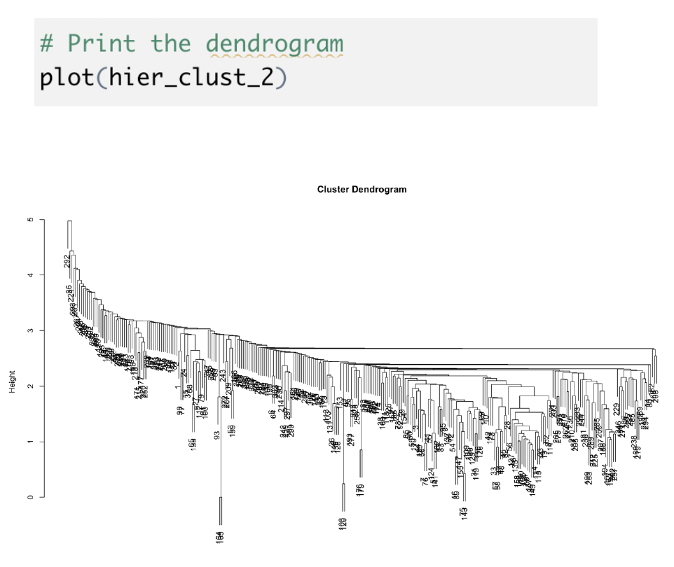

Slide 33
WHAT DOCTORS ACTUALLY WANT TO DO ?
Grouping patients
Difference in hierarchical and why are we choosing it ?
Like the k-means algorithm, the way to evaluate hierarchical clusters is to investigate
which patients are grouped together.
Are there patterns evident in the cluster assignments, or do they seem to be groups of noise?
We're going to examine the clusters resulting from the two hierarchical algorithms
with similar characteristic
Can be treated in a same way as patients in the same cluster / group
Lets Visualize the hierarchical clusters now

Slide 34
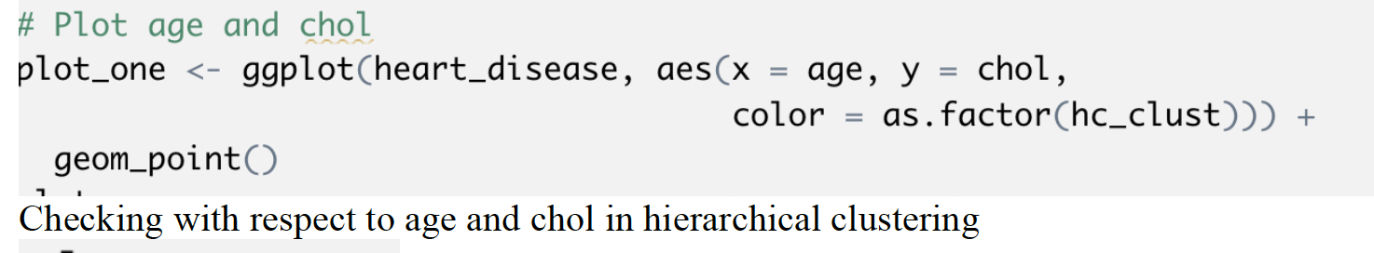
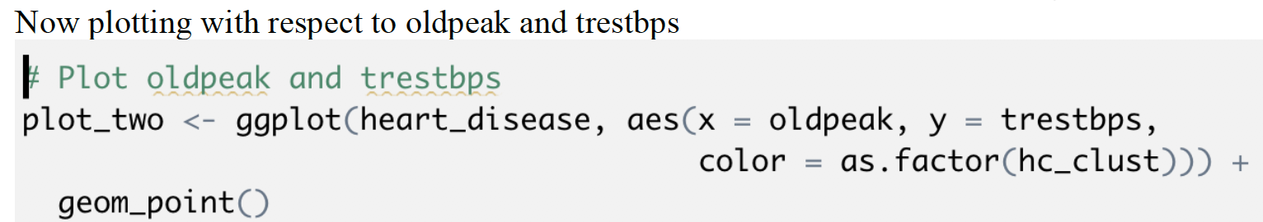
USING SCATTER PLOT

Slide 35
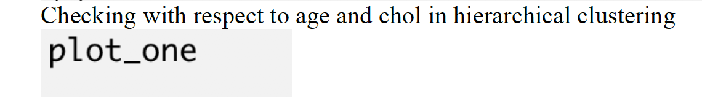
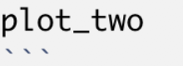
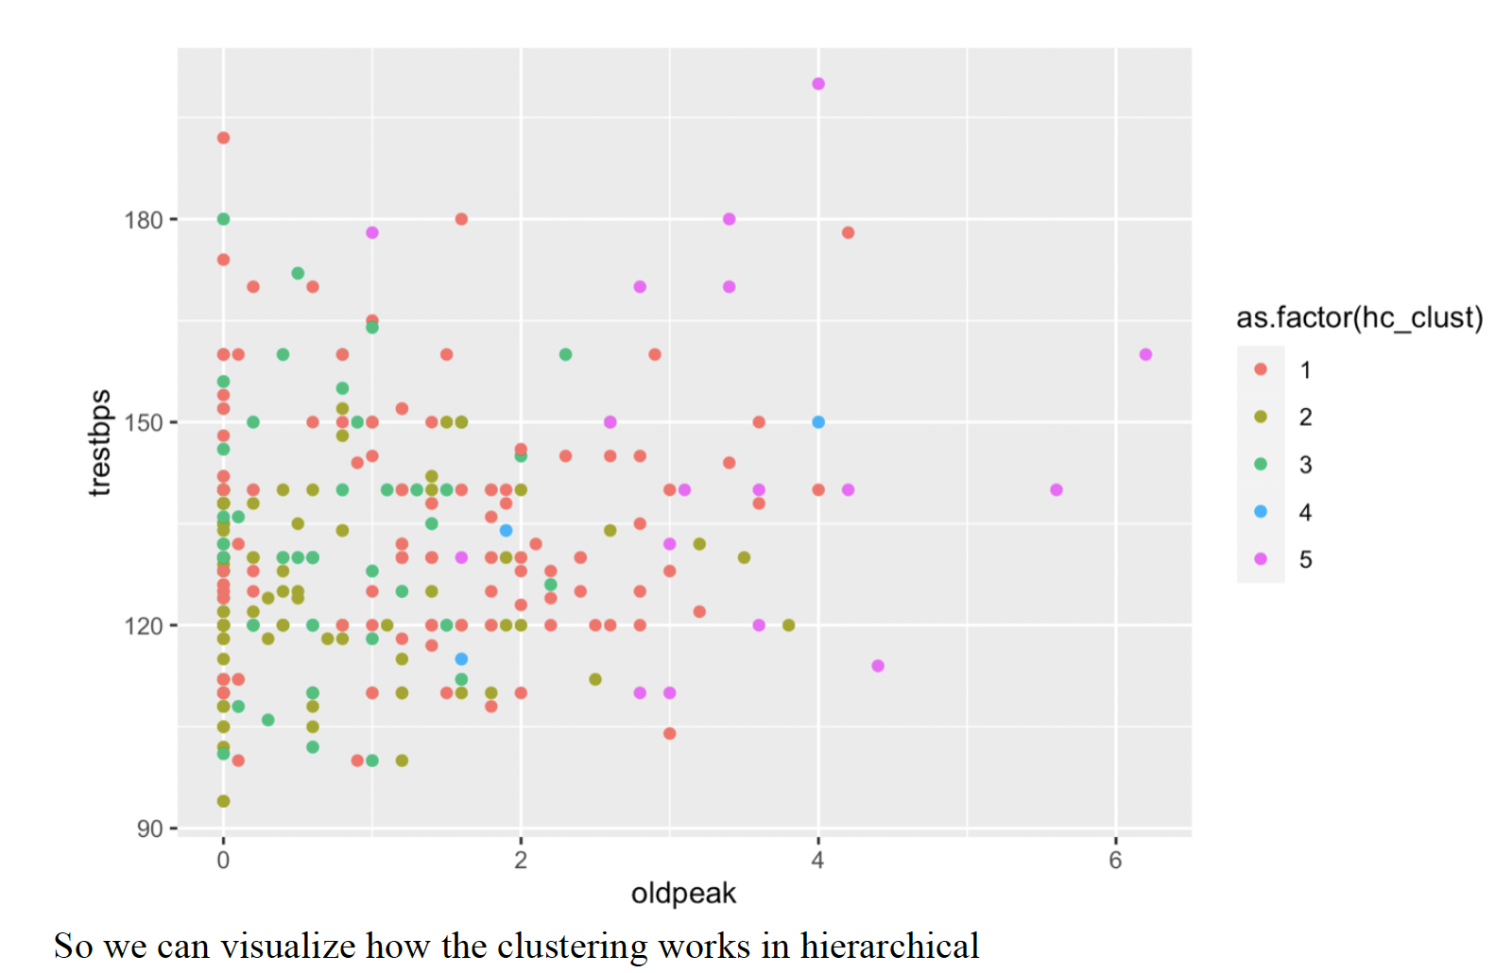
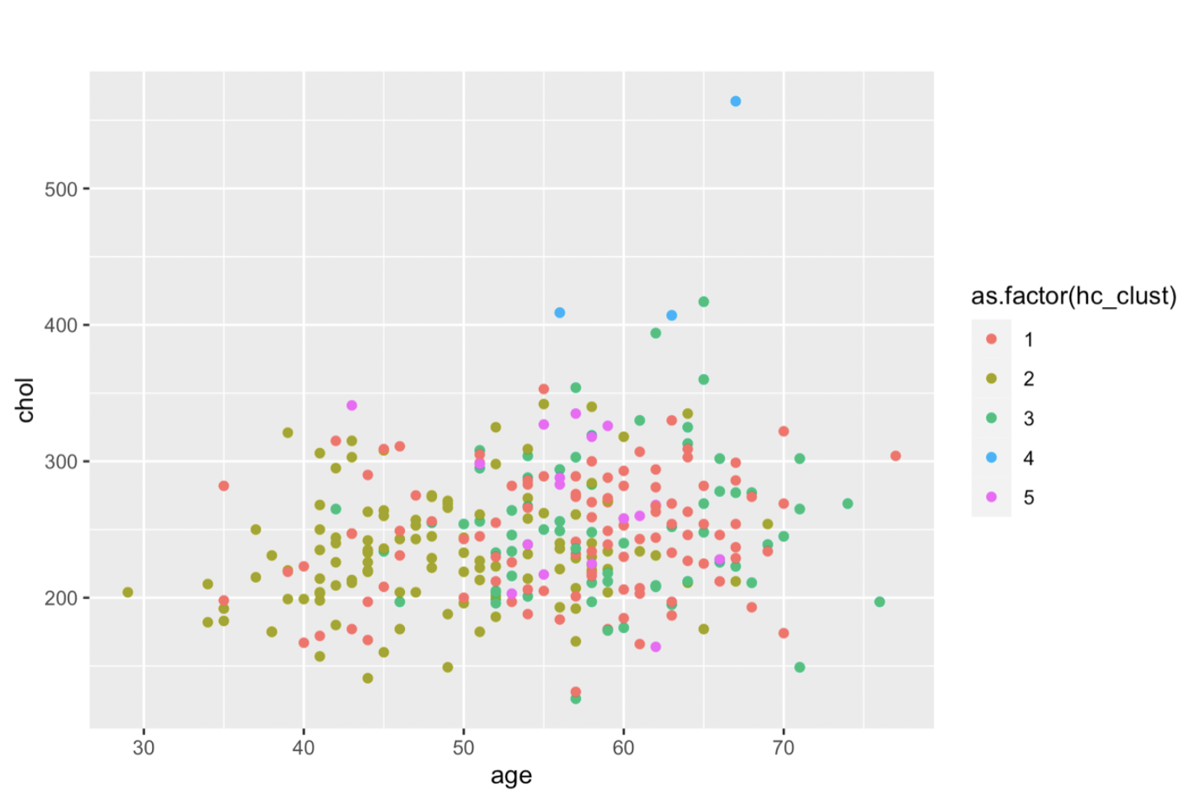
PLOT1 & PLOT2

Slide 36
FINAL RESULTS
K- Means
Hierarchical (single)
Does not group patients in an efficient clustering technique
Not a good option to cluster because of a single branch
Hierarchical (complete)
Efficient and complete structure to group

Slide 37

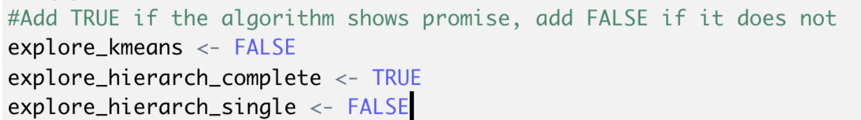
FINAL INSIGHTS
K - MEANS
similar clusters must be produced for each iteration of the algorithm to make sure that the algorithm clusters the signal, not the noise.
we would see similar groups of patients showing up in the plots from the different iterations of the algorithm
For Doctors
we also want to have multiple patients in each group so they can compare treatments.
04
03
02
01
Hierarchical (Complete)
method that puts a balanced number of patients in each group.
Content Here
Get a modern PowerPoint Presentation that is beautifully designed.

Slide 38

REFERENCES
Content Here
https://archive.ics.uci.edu/ml/datasets/heart+Disease
LAST ACC : 8th Dec 2020
https://rstudio.com
( Last Acc 8th Dec 2020)
Data Science With R course
HARVARD
Last acc : 8th Dec 2020
Data Science for all channel , Youtube
(Last Accessed 8th Dec 2020)

Slide 39


Reducing Traffic Mortality in the USA

Slide 40

MOTIVATION
Traffic Mortality
Traffic – most common problem of getting late or accidents occurring
no. of vehicle α traffic related fatalities
not able to predict
Difficult to predict due to what the accidents occur during the traffic
people die
Road traffic injuries in USA kills 154,089 people each year
12% of the road traffic deaths worldwide

Slide 41
Methodology
DATA – MINING
DATA WRANGLING
GROUPING STATES - CLUSTERING
OTHERS
cleaning, Visualizing, analyzing and correlating our data
To analyze the data to achieve the analytical goal of the traffic
plotting, dimensionality reduction
Using unsupervised learning clustering techniques
By grouping - will group the states and check the accidents rate

Slide 42
LANGUAGE AND SOFTWARE
PYTHON
JUPYTER NOTEBOOK
WINPY

Slide 43
PYTHON LIBRARIES
Pandas (pd)
numpy
matplotlib
Sikit learn
seaborn

Slide 44
ALGORITHMS
Pearson Correlation Coefficient
the most common methods to quantify correlation between variables.
Scree Plot
Multivariate Linear Regression
It is a line plot
estimates a single regression model with more than one outcome variable.
K – means Clustering
Principal Component Analysis
tries to partition the dataset into distinct non-overlapping subgroups (clusters)
reduces the dimensionality of the data while retaining most of the variation in the data set

Slide 45
OUTPUT

Slide 46
OUT[1]
C:\myProject\WinPY\WPy64-3830\notebooks
OUT[2]
Changed Directory:
D:\NYIT (Fall2020-ACADEMICS)\INTRODUCTION TO DATA MINING (CSCI657 or CSCI415) [PROFF Helen Gu]\Final Projects
\PROJECT1 PYTHON\datasets
List Of Files: DataSet Link.txt miles-driven.csv road-accidents.csv
First 20 Lines of Dataset miles-driven.csv:
'state|million_miles_annually\n', 'Alabama|64914\n', 'Alaska|4593\n', 'Arizona|59575\n', 'Arkansas|32953\n’, 'California|320784\n', 'Colorado|46606\n', 'Connecticut|31197\n', 'Delaware|9028\n', 'District of Columbia|356
8\n', 'Florida|191855\n', 'Georgia|108454\n', 'Hawaii|10066\n', 'Idaho|15937\n', 'Illinois|103234\n', 'Indiana
|76485\n', 'Iowa|31274\n', 'Kansas|30021\n', 'Kentucky|48061\n', 'Louisiana|46513\n’
First 20 Lines of Dataset road-accidents.csv:
'##### LICENSE #####\n', '# This data set is modified from the original at fivethirtyeight (https://github.co m/fivethirtyeight/data/tree/master/bad-drivers)\n', '# and it is released under CC BY 4.0 (https://creativecom mons.org/licenses/by/4.0/)\n', '##### COLUMN ABBREVIATIONS #####\n', '# drvr_fatl_col_bmiles = Number of drive rs involved in fatal collisions per billion miles (2011)\n', '# perc_fatl_speed = Percentage Of Drivers Involv ed In Fatal Collisions Who Were Speeding (2009)\n', '# perc_fatl_alcohol = Percentage Of Drivers Involved In F atal Collisions Who Were Alcohol-Impaired (2011)\n', '# perc_fatl_1st_time = Percentage Of Drivers Involved In Fatal Collisions Who Had Not Been Involved In Any Previous Accidents (2011)\n', '##### DATA BEGIN #####\n', 's tate|drvr_fatl_col_bmiles|perc_fatl_speed|perc_fatl_alcohol|perc_fatl_1st_time\n', 'Alabama|18.8|39|30|80\n', 'Alaska|18.1|41|25|94\n', 'Arizona|18.6|35|28|96\n', 'Arkansas|22.4|18|26|95\n', 'California|12|35|28|89\n', 'Colorado|13.6|37|28|95\n', 'Connecticut|10.8|46|36|82\n', 'Delaware|16.2|38|30|99\n', 'District of Columbia| 5.9|34|27|100\n', 'Florida|17.9|21|29|94\n'

Slide 47
Brief Description Of Dataset road-accidents.csv Stored In DataFrame Object car_acc:
There are 51 rows and 5 columns.
<class 'pandas.core.frame.DataFrame'>
RangeIndex: 51 entries, 0 to 50 Data columns (total 5 columns):
# Column Non-Null Count Dtype
--- ------ -------------- -----
state 51 non-null object
drvr_fatl_col_bmiles 51 non-null float64
perc_fatl_speed 51 non-null int64
perc_fatl_alcohol 51 non-null int64 4 perc_fatl_1st_time 51 non-null int64 dtypes: float64(1), int64(3), object(1) memory usage: 2.1+ KB
None
Brief Description Whether DataFrame Object car_acc Consists Any NaN Values: state 0 drvr_fatl_col_bmiles 0 perc_fatl_speed 0 perc_fatl_alcohol 0 perc_fatl_1st_time 0 dtype: int64
Following Is The Generic Overview Of DataFrame Object car_acc:
Out[3]:
state | drvr_fatl_col_bmiles | perc_fatl_speed | perc_fatl_alcohol | perc_fatl_1st_time
Alabama | 18.8 | 39 | 30 | 80
Alaska | 18.1 | 41 | 25 | 94
Arizona | 18.6 | 35 | 28 | 96
Arkansas | 22.4 | 18 | 26 | 95
California | 12.0 | 35 | 28 | 89

Slide 48
Out[4]:
 | drvr_fatl_col_bmiles | perc_fatl_speed | perc_fatl_alcohol | perc_fatl_1st_time
count | 51.000000 | 51.000000 | 51.000000 | 51.00000
mean | 15.790196 | 31.725490 | 30.686275 | 88.72549
std | 4.122002 | 9.633438 | 5.132213 | 6.96011
min | 5.900000 | 13.000000 | 16.000000 | 76.00000
25% | 12.750000 | 23.000000 | 28.000000 | 83.50000
50% | 15.600000 | 34.000000 | 30.000000 | 88.00000
75% | 18.500000 | 38.000000 | 33.000000 | 95.00000
max | 23.900000 | 54.000000 | 44.000000 | 100.00000

Slide 49

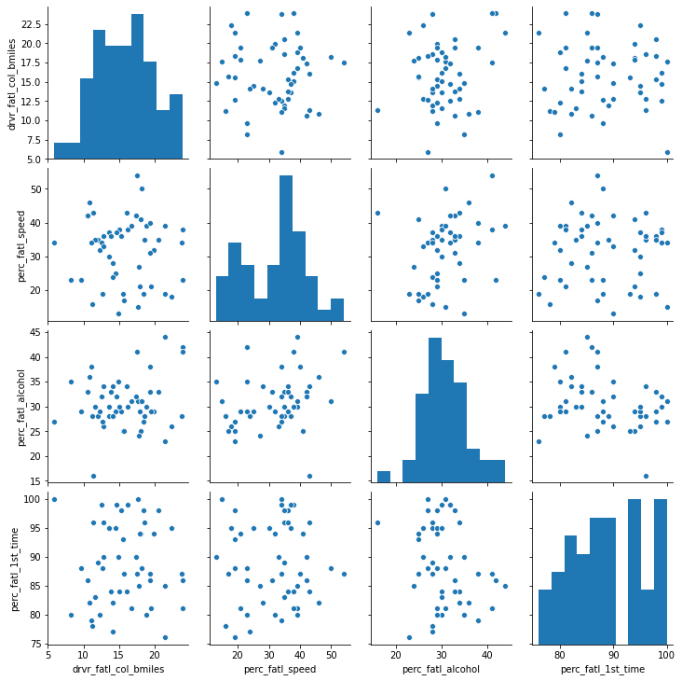
Out[5]
<seaborn.axisgrid.PairGrid object at 0x00000258A9616CD0>

Slide 50
Out[6]:
 | drvr_fatl_col_bmiles | perc_fatl_speed | perc_fatl_alcohol | perc_fatl_1st_time
drvr_fatl_col_bmiles | 1.000000 | -0.029080 | 0.199426 | -0.017942
perc_fatl_speed | -0.029080 | 1.000000 | 0.286244 | 0.014066
perc_fatl_alcohol | 0.199426 | 0.286244 | 1.000000 | -0.245455
perc_fatl_1st_time | -0.017942 | 0.014066 | -0.245455 | 1.000000

Slide 51
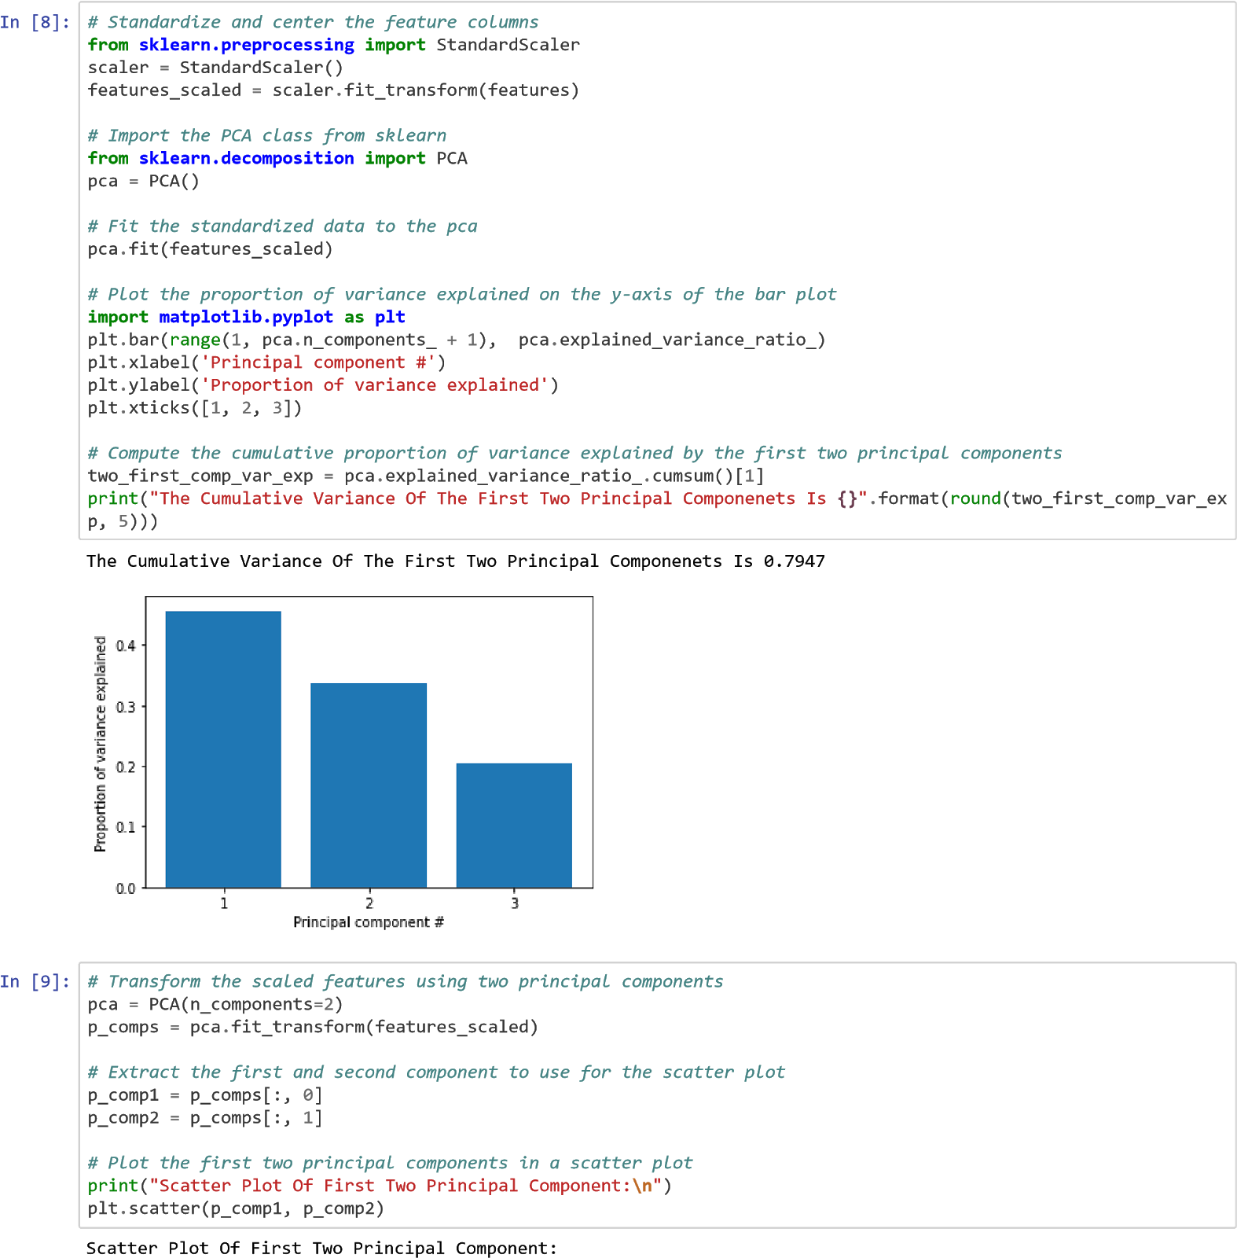
<class ‘sklearn.linearmodel._base.linearRegression’>
<class 'numpy.ndarray'>
Out[7]: array([-0.04180041, 0.19086404, 0.02473301])
Out[8]

Slide 52
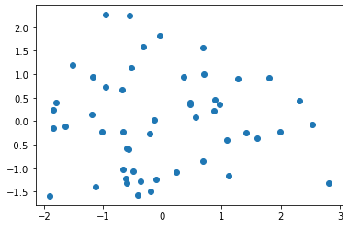
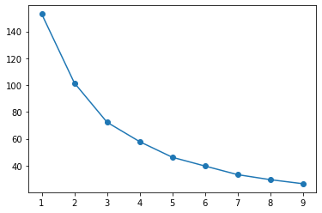
Out[9]: <matplotlib.collections.PathCollection at 0x258ae817610>
Out[10]
<matplotlib.lines.Line2D at 0x258aeee 9e80>]
=
3
=
8
)
km
.
(
)
# Create a scatter plot of the first two principal components
# and color it according to the KMeans cluster assignment
print
(
\n
"
)
plt
[:
,
]
,
[:
,
]
,
.
scatter
(
p_comps
0
p_comps
1
=
km
.
bels_

Slide 53
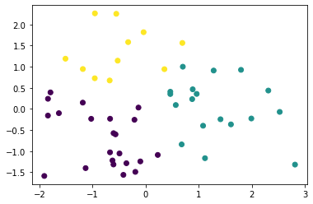
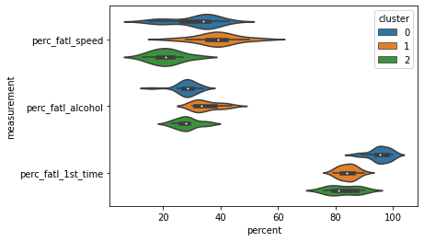
Out[11]: <matplotlib.collections.PathCollection at 0x258ae029520>
Out[12]: <matplotlib.axes._subplots.AxesSubplot at 0x258adf 4b310>

Slide 54
miles_driven.head()
Brief Description Of Dataset miles-driven.csv Stored In DataFrame Object miles_driven:
There are 51 rows and 2 columns.
<class 'pandas.core.frame.DataFrame'>
RangeIndex: 51 entries, 0 to 50 Data columns (total 2 columns):
# Column Non-Null Count Dtype
--- ------ -------------- -----
0 state 51 non-null object 1 million_miles_annually 51 non-null int64 dtypes: int64(1), object(1) memory usage: 944.0+ bytes
None
Brief Description Whether DataFrame Object miles_driven Consists Any NaN Values: state 0 million_miles_annually 0 dtype: int64
Following Is The Generic Overview Of DataFrame Object miles_driven:
Out[13]:
States | Million_miles_annually
Alabama | 64914
Alaska | 4593
Arizona | 59575
Arkansas | 32953
California | 320784

Slide 55
Out[14]
 | State | Billion_miles_annually
1 | Alabama | 64.914
2 | Alaska | 4.593
3 | Arizona | 59.575
4 | Arkansas | 32.953
5 | California | 320.784
Out[15]:
States | Drvr_fatl_col_bmiles | Perc_fatl_speed | Perc_fatl_alcohol | Perc_fatl_1st_time | Cluster | Billion_miles_annually
0 Alabama | 18.8 | 39 | 30 | 80 | 1 | 64.914
1 Alaska | 18.1 | 41 | 25 | 94 | 0 | 4.593
2 Arizona | 18.6 | 35 | 28 | 96 | 0 | 59.575
3 Arkansas | 22.4 | 18 | 26 | 95 | 0 | 32.953
4 California | 12.0 | 35 | 28 | 89 | 0 | 320.784

Slide 56
Out[16]:
state | drvr_fatl_col_bmiles | perc_fatl_speed | perc_fatl_alcohol | perc_fatl_1st_time | cluster | billion_miles_annually | num_drvr_fatl_col
Alabama | 18.8 | 39 | 30 | 80 | 1 | 64.914 | 1220.3832
Alaska | 18.1 | 41 | 25 | 94 | 0 | 4.593 | 83.1333
Arizona | 18.6 | 35 | 28 | 96 | 0 | 59.575 | 1108.0950
Arkansas | 22.4 | 18 | 26 | 95 | 0 | 32.953 | 738.1472
California | 12.0 | 35 | 28 | 89 | 0 | 320.784 | 3849.4080

Slide 57
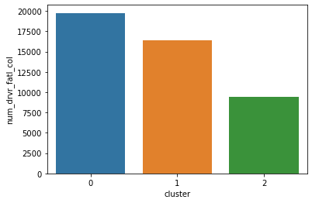
Out[17]:
cluster count mean sum
Out[18]
Following Are The Respective States Corresponding To Cluster 0:
Alaska
Arizona
Arkansas
California
Colorado
Delaware
District of Columbia
Florida
Georgia
Idaho
Illinois
Indiana
Louisiana
Maryland
Mississippi
Nevada
New Mexico
Oklahoma
Oregon
Utah
Vermont
West Virginia
0 22 898.378595 19764.3291
1 18 911.406439 16405.3159
2 11 860.505945 9465.5654

Slide 58
REFERENCE
https://www.paho.org/hq/index.php?option=com_content&view=article&id=5163:about-road-safety&Itemid=39898&lang=en
Last Acc 8th Dec 2020
https://github.com/shubendu/Reducing-Traffic-Mortality-in-theUSA/blob/master/datasets/
LAST ACC : 8th Dec 2020
Data Science With python
Last acc : 8th Dec 2020
https://learn.datacamp.com/projects/462
(Last Accessed 8th Dec 2020)

Slide 59
WORK DONE
MEHREET SINGH BAJAJ (1274698)
Understanding R and doing crash course
(Harvard Data Science certificate in R)
• Datacamp python course
• Installing and running r environment and R-studio
software
• Understanding the basic concept of both projects in
python and R
• Making the report in a proper structure and explaining it
• Understanding working of Tableau software
• Presentation Creation and ideas
MAITRY JARIWALA(1275288)
Understanding and creating the core of Tableau
Differentiating the datasets
Visualize COVID 19 Dataset
Showed the complete Demonstration in the Presentation
Visualization in python project
Presentation creation and ideas
Understanding the basic concept of both the projects in python and R
RISHABH BADJATYA(1270662)
Created a Synchronized Dashboard in Tableau
Plot various Graphs 📈
Visualize COVID 19 Dataset
Showed the complete Demonstration in the Presentation
Visualization in python project
Manipulation in Python Project
Tableau 2020 : A-Z : Hands on Tableau Training for Data Scinece - Udemy
Data Visualization in Tableau : Data Camp
MOHAMMED SAFWAN ASLAM KAZI
Reducing Traffic Mortality in The USA
• Understanding Concepts of Python3
• Machine Learning Algorithms,
• Installation of Python3, WinPY and Jupyter Notebook,
Coding, Development and Deployment of Project)
• Report For Project 2 :- Reducing Traffic Mortality in
The USA.

Slide 60


TEAM EFFORT
THESE PROJECTS WERE SUCCESSFUL BECAUSE OF EFFORTS OF ALL TEAMMATES

Slide 61




